Slide 1
SearchPath
A tool for investigating the magnetic field produced by a buried avalanche transceiver

Slide 2
History
1971 first transceiver: 2.275 kHz
1972 VS68: 457 kHz
1972 – 1986 "frequency war"
1995+ going digital
1997+ 2 antenna devices
2003+ 3 antenna devices

Slide 3
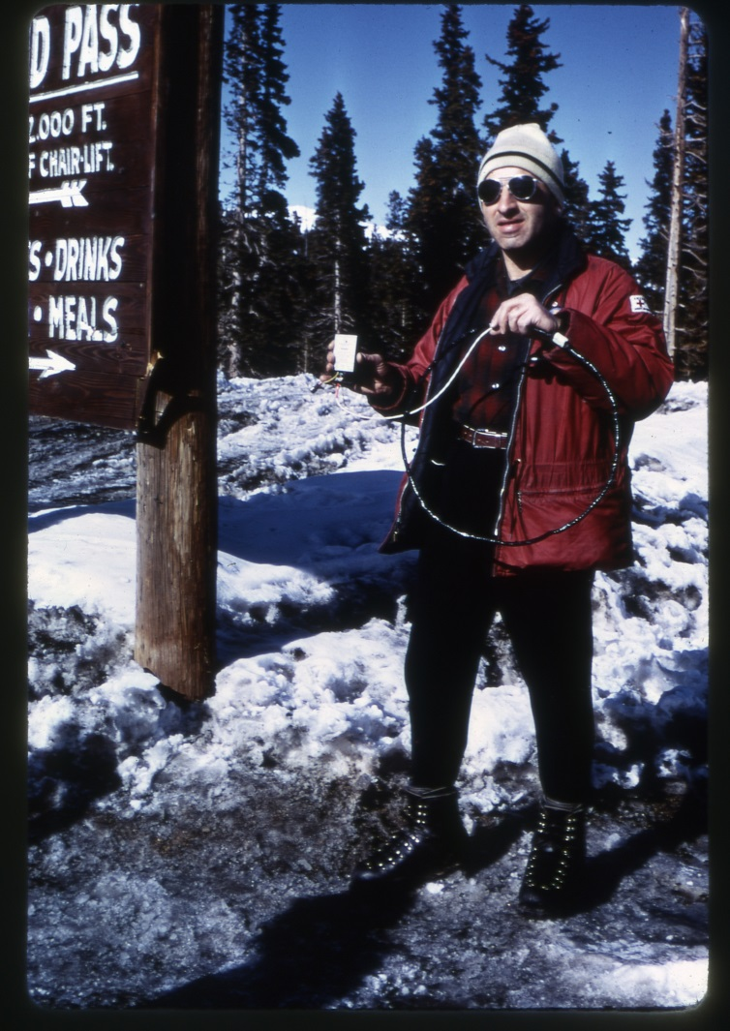
John Lawton on
Berthoud Pass, CO
November 1968
Note circular loop antenna

Slide 4
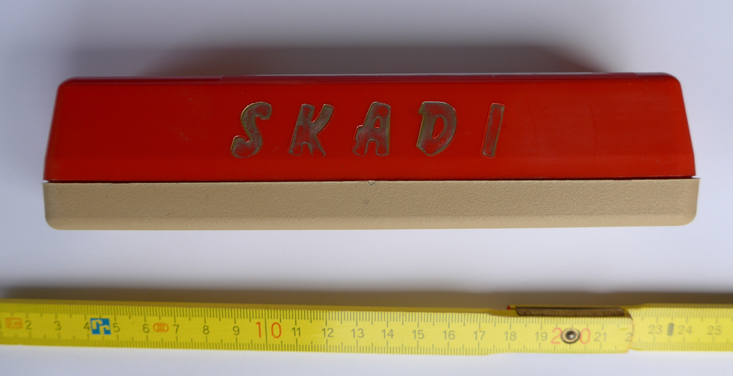
The "Hot Dog"

Slide 5
Display Information
on a searching transceiver (distance and direction) is derived from
Strength
Direction
of the incident magnetic field lines at the searching transceiver

Slide 6
Field Lines at Searching Transceiver

Slide 7
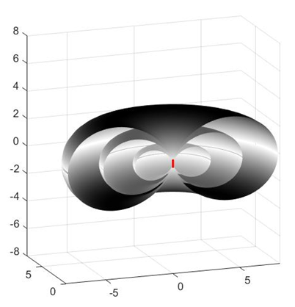
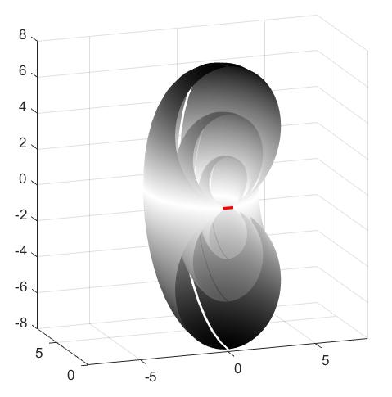
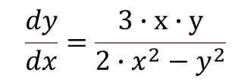

Homogeneous Space
$$\frac{dy}{dx}=\frac{3∙x∙y}{2∙x^{2}−y^{2}}$$
Integrated :
$$x^{2}+y^{2}=C∙y^{\frac{4}{3}}$$
Closed Form
Solution
Vertical Antenna
Horizontal Antenna

Slide 8
Layered (inhomogeneous) Space
No closed form solution available !

Slide 9
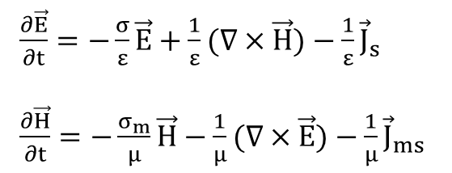
FDTD (Finite Difference Time Domain) Algorithm
The Maxwell Equations:
$\frac{∂\vec{E}}{∂t}=−\frac{σ}{ε}\vec{E}+\frac{1}{ε}(∇×\vec{H})−\frac{1}{ε}{\vec{J}}_{s}$
$\frac{∂\vec{H}}{∂t}=−\frac{σ_{m}}{μ}\vec{H}−\frac{1}{μ}(∇×\vec{E})−\frac{1}{μ}{\vec{J}}_{ms}$
Stepwise numerical integration of differential equations,
similar to weather forecast algorithms

Slide 10
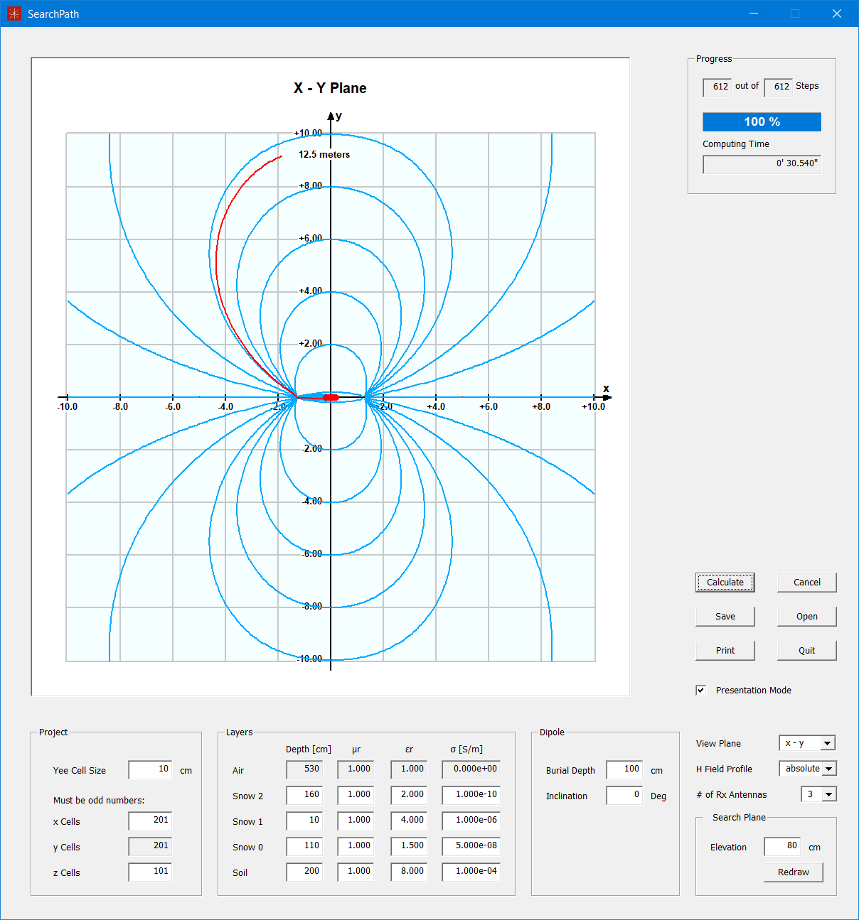
Horizontal
Antenna

Slide 11
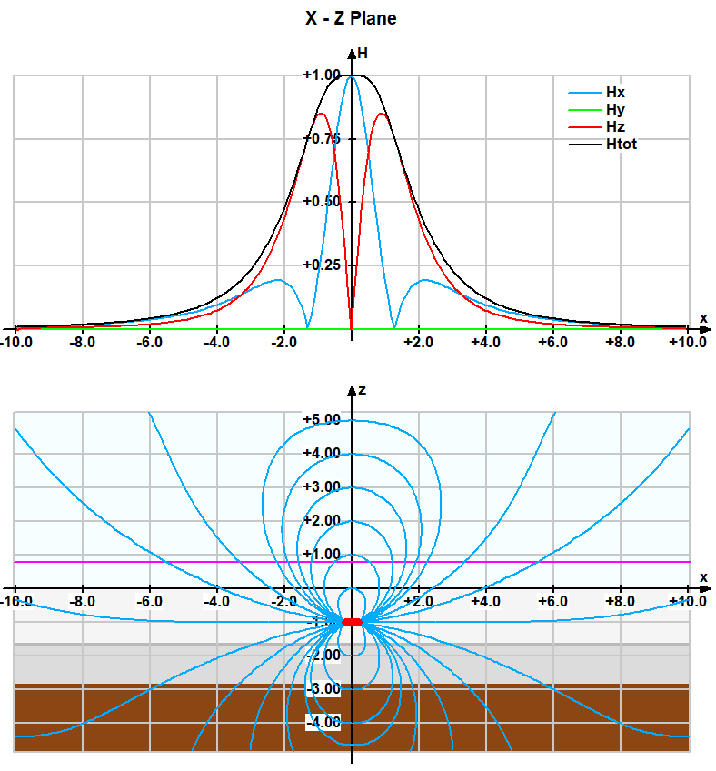
Horizontal
Antenna

Slide 12
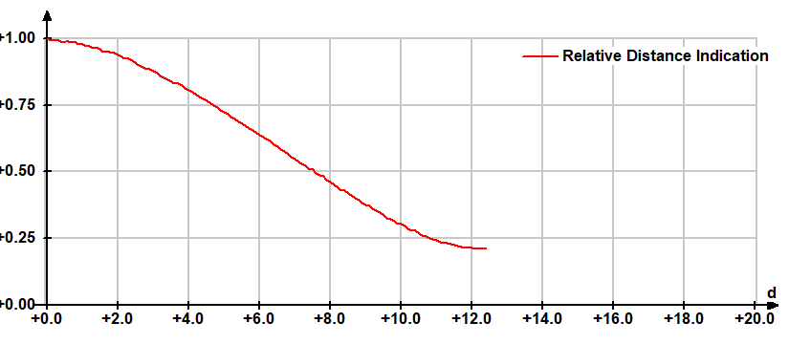
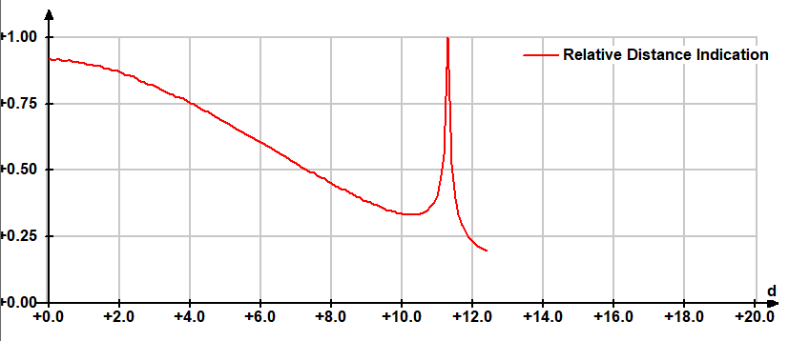
The 3rd Antenna does make a difference !
3 Antennas
2 Antennas

Slide 13
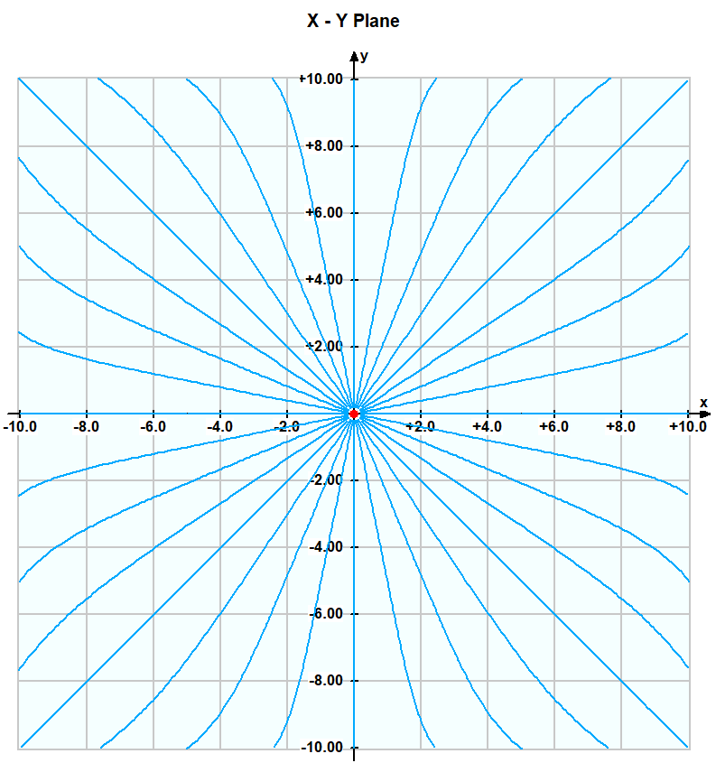
Vertical
Antenna

Slide 14
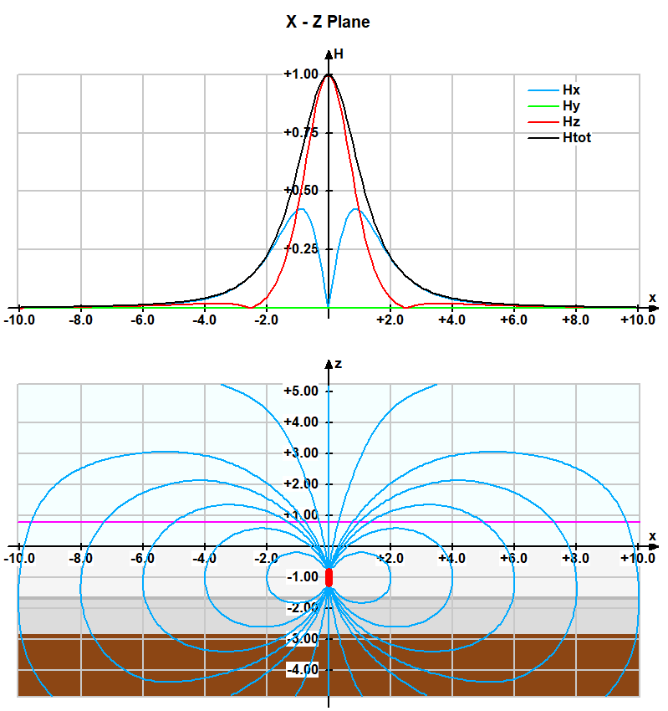
Vertical
Antenna

Slide 15
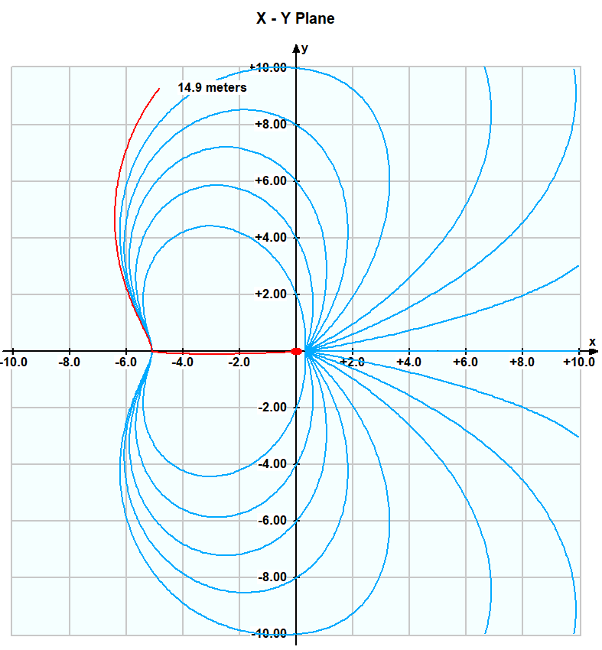
60° Inclined
Antenna
Search Path

Slide 16
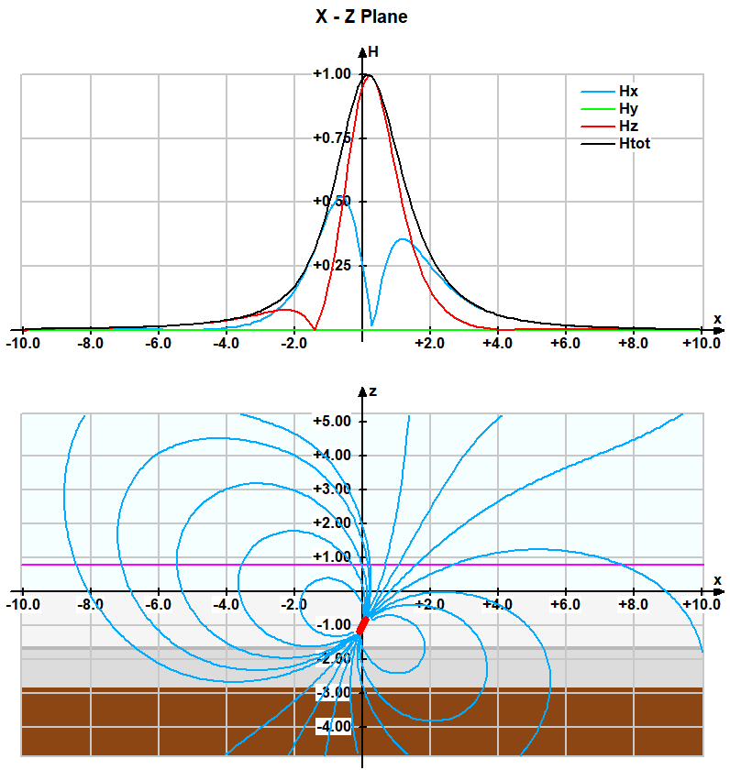
60° Inclined
Antenna

Slide 17
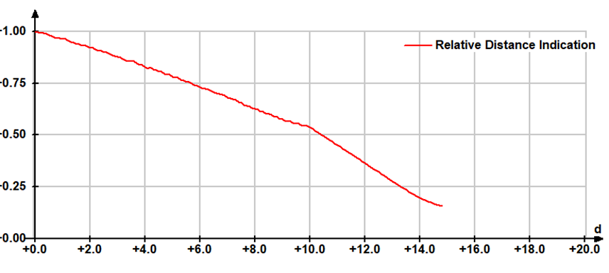
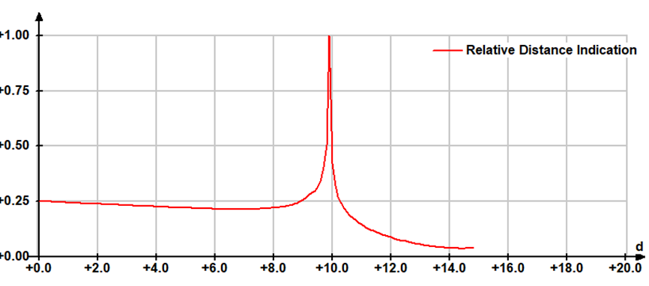
60° Inclined Antenna
3 Antennas
2 Antennas

Slide 18
Use this program for
personal investigations / studies
designing challenging training scenarios
preparing graphics for documentation and manuals
developing new (better?) transceivers

Slide 19
To download the program, the user manual and the technical documentation, go to
https://felmeier.com/en/software/SearchPath
It’s all free !
Thank you for your attention !

